Slide 1
ADVANCED SOFTWARE ARCHITECTURE AND DESIGN
KWIC(Key Word In Context) System
Interim Project –I

Slide 2
Team Members
Archana Jaganathan Thyagaraj Vuppulapati
Vignesh Sridhar Arunkumar Manickam
Ashwin K Mishra Vishnuvaradhan L
Giridharan Subramanian Prasanna Venkatesh
Hariprasad Natarajan Rekha Muthulakshmi
Sindhu P Manjari Sriram Sridharan

Slide 3
Team Organization
Leadership Rotation “to be updated”
Role Rotation
Phase | Leader(s)
Phase I - Interim
Phase I - Final
Phase II- Interim
Phase II - Final
Phase | Requirements Engineering | Architecture | Implementation | Testing
Phase I
Phase II

Slide 4
Agenda
ASAD
Project Overview
Requirements Analysis
Architectural Styles
Implementation
Demo
Test Plan
Conclusion

Slide 5
PROJECT OVERVIEW

Slide 6
To architect a KWIC software system and implement it, which will later be used for a web search engine.
Web-based Interface for Key Word Indexing
T-REX Search Engine

Slide 7
Process Model
Scrum-Agile software development framework
Iterative
Incremental
Fast and flexible

Slide 8
REQUIREMENTS ANALYSIS

Slide 9
Functional Requirements
Functional Requirements define the capabilities and functions that a system must be able to perform successfully. They should include:
Description of data to be entered into the system
Description of operations performed by each screen
Description of work-flows performed by the system
Description of system reports or other outputs
Who can enter the data into the system.
Notes:
Reference: http://www.ofnisystems.com/services/validation/functional-requirements/

Slide 10
Functional Requirements of KWIC
The system shall accept an ordered set of lines, where each line is an ordered set of words, and each word is an ordered set of characters.
Any line shall be “circularly shifted” by repeatedly removing the first word and appending it at the end of the line.
The system shall output a listing of all circular shifts of all lines in ascending alphabetical order.

Slide 11
Issues with Functional Requirements
IFR1: What are the valid inputs?
Issue:
Incomplete requirement. Does not state what types of input are permitted. For eg, will non alphanumeric characters or special characters be allowed ?
Options :
1. Any character.
2. Special characters.
3. ASCII characters.
4. Languages other than English.
Optimal Choice and Rationale :
Options 1, Any characters. The system shall accept any characters as input and is circular shifted. Any non-alphanumeric character is removed by the alphabetizer before sorting.

Slide 12
IFR5: How many characters of input shall the system support?
Issue:
Incomplete requirement. Does not give any bound for the number of characters that shall be accepted as input.
Options :
1. 0
2. > 1 and < 2048
3. <2048
4. No limit
Optimal Choice and Rationale :
Option 2. Our attempt is to follow the guidelines of the Google search engine and hence the application allows user to enter up to a maximum of 2048 characters.

Slide 13
Functional Requirements with ambiguities resolved
FR1 The system shall accept key stroke and pasted characters as input.
FR2 The system shall accept input up to a maximum of 2048 characters including delimiter.

Slide 14
Non Functional Requirements
Non-Functional requirements are often associated with the state of the system and not with the functionality that the system has to offer.
Examples of Non Functional Requirements:
Scalability
Interoperability
Maintainability
Portability
Performance
Security

Slide 15
Non Functional Requirements of KWIC
The system shall be “understandable”.
The system shall be “portable”.
The system shall be “enhanceable”.
The system shall be “reusable”.
The system shall have “good performance”.
The system shall be “user-friendly”.
The system shall be “responsive”.
The system shall be “adaptable”.

Slide 16
Issues with Non Functional Requirements
INFR1: The system shall be understandable
Issue:
The term “understandable” is ambiguous and needs more clarity.
Options:
Text is easy to read
Low learning curve for user
Low learning curve for developer
Choices: Option 1, 2, 3

Slide 17
INFR: The system shall be “user-friendly”.
Issue:
The notion of “user-friendliness” is highly subjective. A system may or may not be user friendly depending on individual perspective.
Options:
1. Label the various fields on the GUI with meaningful text.
2. Provide balloon help on the GUI for various fields.
3. Develop a user manual.
Choice and Rationale:-
All options. Proper labels will help the user identify and use a field in a manner consistent with its intended purpose. Balloons will help assist the end user with a more detailed help text, if necessary. A user manual can provide the user with additional help. All three options are feasible for this project.

Slide 18
ARCHITECTURAL STYLES

Slide 19
Shared Data Design
Data between the components through shared storage.
Read & Write protocol
Input module
Input read
Operation store
Module Circular shift
Operation readChar
Operation prepare

Slide 20
Shared Data Design (Contd)
Module Alphabetizer
Operation readChar
Operation readIndex
Module Output
Operation readChar
Operation readIndex
Operation print
Module Master Control
Operation main

Slide 21
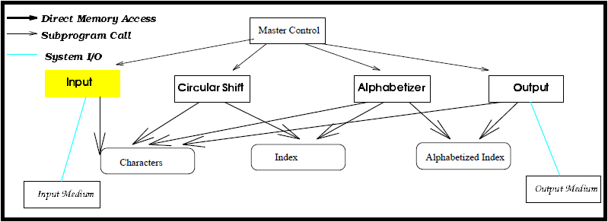
Design Diagram

Slide 22
Advantages and Disadvantages
Advantages
Performance - This model offers the best efficiency as shared between the components therefore is not duplicated.
Faster
Memory efficient
Disadvantages
Modifiability - Strong coupling between the components makes modifiability difficult.
Enhanceability - Difficult to enhance the system by adding new components.
Reusability – Since the components are highly dependent on each
other, it is highly difficult to reuse any of the components in other systems.

Slide 23
Pipe and Filter
Each component has a set of inputs and outputs
Filter
Reads input streams of data.
Applies a local transformation.
Produces the output streams Incrementally.
Pipes
Serves as conduits for the stream.
Transforms output of one filter to input of of another.

Slide 24
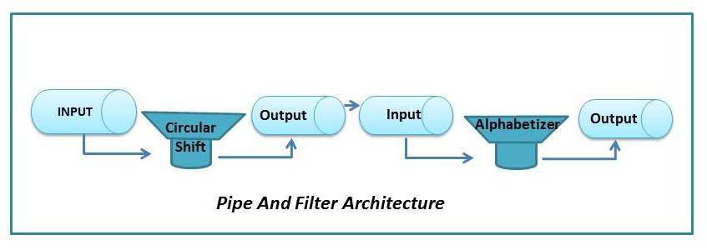
Design Diagram

Slide 25
Advantages and Disadvantages
Advantages
Modifiability - Due to process independence.
Good maintainability and enhanceability- Modification on one module can be done without affecting others.
Good understandability - Model is easy to understand.
Disadvantages
Performance – Data replications causes degradation in performance.
Limited generality – More suited for layered systems.
Low user friendly – Not suitable for interactive applications.

Slide 26
IMPLEMENTATION

Slide 27
Implementation
Implemented the JavaScript using Eclipse.
Pipe and Filter and Shared Data has been used.
Tested it by running it on browser.
Site to run the code:
http://kwicsystem.appspot.com/Project-KWIC.html

Slide 28
DEMONSTRATION

Slide 29
TEST PLAN

Slide 30
Test Plan
Test plan was started before implementation.
Test cases planned as per the requirements document and architecture documents.
There are two types of test plans:
1. NFRs
2. FRs

Slide 31
NFR Test Cases
Understandability
Portability
Good Performance
User-friendly
Responsiveness
Adaptable

Slide 32
Sample Test Case “to be updated”
Test case identifier: | NFR7_Performance
Test items: | Output area.
Input specifications: | Input text with lines = 10.
Output specifications: | An input of 10 lines was tested and output was obtained in less than a second.
Environmental needs: | Web browser on client PC or Laptop.
Special procedural requirements: | None.
Inter-case dependencies: | This test case relies on the availability of KWIC system.

Slide 33
FRs test cases
Input Verification
Circular Shifting each line
Delimiter
Input methods
Max Characters
Output Verification

Slide 34
Sample Test Case “to be updated”
Test case identifier: | FR7_Max characters
Test items: | Input area
Input specifications: | Enter more than 2048 characters (including the delimiters)
Output specifications: | User should NOT be able to input more than 2048 characters.
Environmental needs: | Web browser on client PC or Laptop.
Special procedural requirements: | None.
Inter-case dependencies: | None.

Slide 35
Tasks to do:
Noise Eliminator.
Enhancements of the UI.

Add tips and hints to each UI control.
Further improve the user manual and other documents from the Phase 1 Interim.


Slide 36
Why are we the best?
Dedicated to addressing the requirements.
Focused on delivering the best product .
Constant endeavor to improve the product .
Always considering new approaches.
Committed to the quality of our process.
Good Process = Good Product

Slide 37
THANK YOU

